Slide 1
QF621 Quant Trading Strategies
Team:
ER HWA MING 01477223
JOHANN FONG CHEOK ARN 01294185
LIM WEN KAI JONATHAN 01484523
OW WAI TING 01332586
SIM SHAN QIN 01329428

Slide 2
Investment objectives
We identify a mean reversion framework for stock picking across the Japan equity markets to construct a market neutral - low net and factor exposure portfolio, where we believe will deliver high risk adjusted returns and can be scalable given the depth and breadth of the Japanese market.

Slide 3
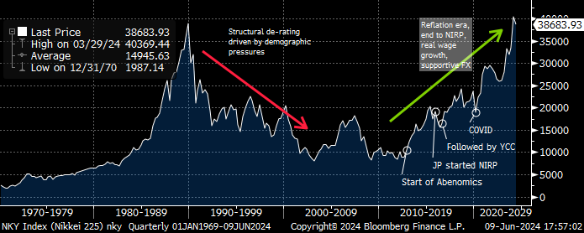
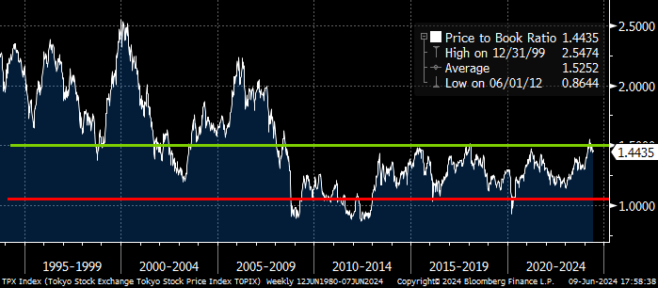
Why Japan? and why now?
The Japan market has typically been a mean reverting market given its aging population demographic dynamics. Post-covid, that view has changed, with market participants believing that the re-emergence of inflation has the power to drive sustained real wage growth. This is supported by a move back to positive interest rates and meaningful corporate governance changes.
Be that as it may, with the Nikkei surpassing its 1989 peak, we believe that the structural re-rating of Japanese markets has played out largely, and from hereon we are likely to swing back to its mean reverting nature. With that view, we look to develop a mean reversion framework.

Slide 4
Phase 1: Data gathering
Defining the universe
Japan: We focus on Japan and narrow our view to the Topix, comprising of 2144 constituents.
The Topix accounts for ~90% of the market, outside of which we believe that liquidity and free float will be a constraint to the execution of our strategy.
Data gathering
Daily price:
10 -year daily price history of the Topix constituents
Possible inclusion of stocks that have been removed from the current index
Price should be adjusted for stock splits and other related actions
GICs classification to cluster stocks
Three levels of GICS classification
Stock market cap
Ideally be able to collect daily market cap data, daily free float market cap data
Daily ADV

Slide 5
Phase 2: Clustering and indexing, aligned correlation and causation
Identifying key trading pairs / clusters
Classify the tradable universe into subsectors clusters where we expect stock within the clusters to exhibit a high level of correlation, given the exposure to similar industry dynamics
We plan on using GICS classifications to bucket into clusters
Our clusters will be back tested for correlations
Finetuning the tradable universe in subsectors
In addition to correlation analysis, we plan to set size and liquidity requirements in order to better align the equity trading dynamics including: (1) market cap, (2) free float market cap, (3) ADV, (4) Stock volatility, (5) Beta
Setting an index benchmark for measuring relative performance
We set a customized benchmark indices on each cluster — this allows us to measure relative out and underperformance for our mean reversion strategy
We plan to have indices constructed on an equal weighting of the stocks this would be a better representation of subsector trend

Slide 6
Phase 3: Setting mean reversion parameters
Share price movement
2 st dev relative vs cluster, 2 st dev valuation move (PE, PB, EV,EBITDA)
Fundamental (possible as trigger or as overlay)
Consensus revision direction change (Revenue / EPS)
Technical factors
Stochastic, RSI, MACD
Consensus rating score change, price target change

Slide 7
Phase 4: Setting entry / sizing targets
Share price movement
2 st dev relative vs cluster, 2 st dev valuation move (PE, PB, EV,EBITDA)
Fundamental (possible as trigger or as overlay)
Consensus revision direction change (Revenue / EPS)
Technical factors
Stochastic, RSI, MACD
Consensus rating score change, price target change

Slide 8
Phase 5: Setting stop loss triggers and exits
Stop loss mechanics
Absolute stock price move, Relative stock move, Relative stock move as % of GMV
Exits: when to exit trade
o Back test for avg peak to trough reversion
o Individual stop losses vs portfolio level drawdowns – fine tune based on backtest
o Technical factors

Slide 9
Output

Slide 10
Key stats

Slide 11
Phase 6: Considerations as we progress
• Setting how the book exits older ideas and adds newer ideas – average holding period
• Number of positions – Deliberate whether to stick to fixed number of positioned (~100 positions) or give flexibility to scale up based on signals
o Decision parameters on ideas to exit when new signals come through
o Positions sizing especially if we do give flexibility on number of positions
• Scalability of the strategy — whether strategy can be scaled from US$100mn to US$1bn
o How to scale - more positions, or larger size – liquidity constraints and market impact studies key
• Sizing variation – stick to equal weighting or look to size up based on certain signals
• Trading Turnover targets – initial start point 10-20% of GMV a day
o Book turns 20% * 250 trading days – to assess associated trading cost implication
• Entry point – Closing price or VWAP based on back test

